Slide 1
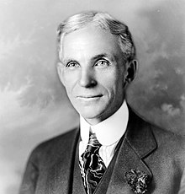
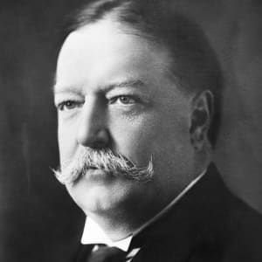
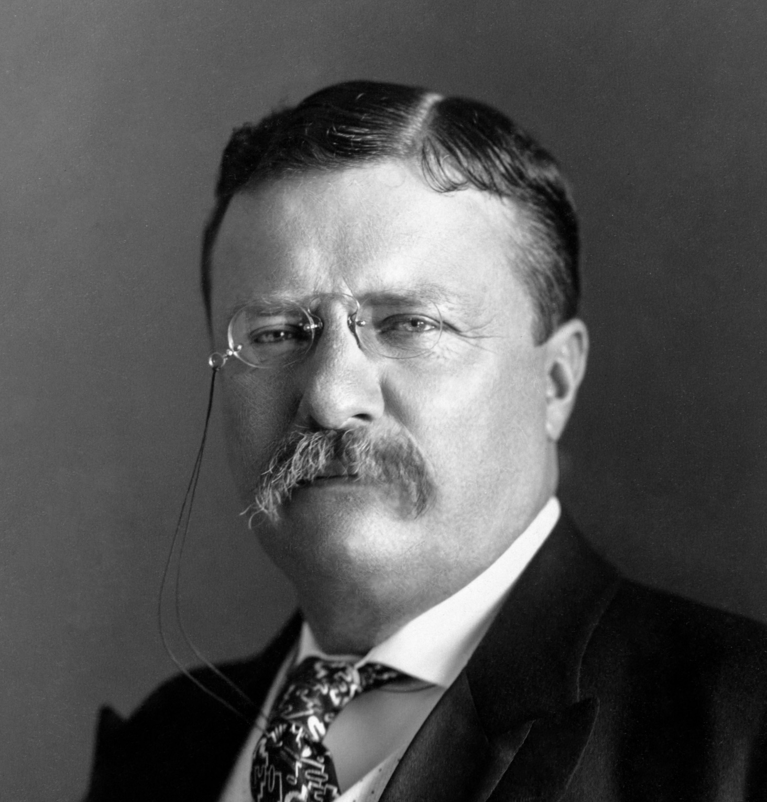
Henry Ford and the Model T Theodore Roosevelt and Expansionism Taft and Economic Reform to Curb Laissez-Faire Policies
Year 11 Modern History

Slide 2
Timeline so far…
End of Civil War 1865
The Gilded Age/Second Industrial Revolution 1865-1900
Progressive Era 1900-1917
Theodore Roosevelt becomes President 1901 – expansionist policies
William Taft becomes President 1908, believes in economic diplomacy
Henry Ford revolutionises assembly line to produce Ford cars (Model T’s)
1913

Slide 3
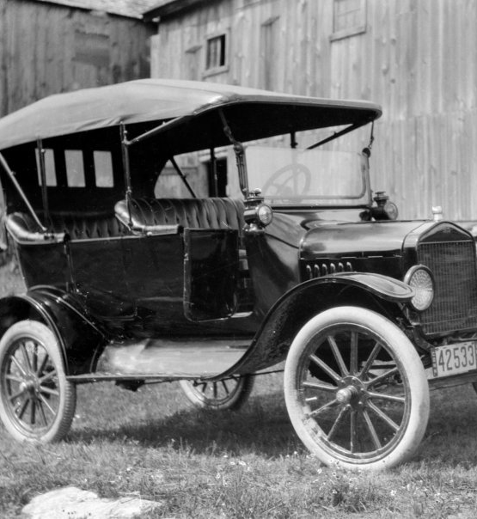
Henry Ford and the Model T https://www.history.com/topics/inventions/henry-ford
1903 established Ford Motor Company, 1908 first Model T (Tin Lizzie)
Overwhelming demand for Model T
Introduced mass-production methods - large production plants, the use of standardised, interchangeable parts and, in 1913, first moving assembly line for cars.
Assembly line reduced production time of a car from 12.5 hours to 1.5 hours.
Cars could be produced quickly and cheaply.
Skilled labourers replaced by cheaper machines.
Ford Motor Company able to produce 1 million Model T’s each year in the 1920s at a much lower cost.
In 1914 Model T cost $850, by 1926 cost $295.
Could produce one Model T every 24 seconds.
Increased the daily wage for an eight-hour day for his workers to $5 (up from $2.34 for nine hours).

Slide 4
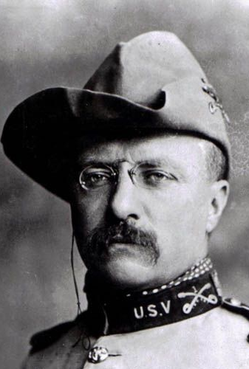
Theodore Roosevelt and Expansionism https://www.history.com/topics/us-presidents/theodore-roosevelt
T. Roosevelt became Republican President 1901.
Known as great “trust buster” for his efforts to break up industrial combinations under the Sherman Antitrust Act (“Square Deal”).
Roosevelt moved from isolationist foreign policy to expansionist policies.
Expansionism: increasing the amount of land ruled by a country (expanding territory), or the business performed by a company (economic expansion).
US believed had a right to intervene in regional politics (Latin America’s) and became ‘international police force’ by ‘speak softly and carry a big stick’.
Beginning construction on the Panama Canal.
Increased navy to become major international force at sea.
Banana Wars

Slide 5

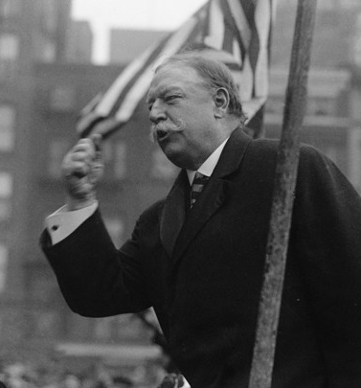
Taft and Economic Reform to Curb Laissez-Faire Policies https://www.history.com/topics/us-presidents/william-howard-taft
Became Republican President 1908.
Differed from Roosevelt as he believed in using economic power, rather than military power to assert control in the region (Dollar Diplomacy).
Laissez-faire: (French) the idea that governments and the law should not interfere with business, finance, or the conditions of people's working lives.
Until 1908 laissez-faire policies dominated US – Taft sought to change.
Set railroad rates.
Supported federal income tax.
Generally, conservative – not supported by progressives.

Slide 6

Key questions
Explain how the Model T changed everyday life in America for the ‘common man’.
1
How did developments in production (assembly line) affect America in the years to come? (focus on 1920s).
2
Theodore Roosevelt was described as a ‘Progressive President’. Identify examples of his Progressive program.
3
How did Taft’s presidency differ from Theodore Roosevelt’s.
4

